Slide 1
Basic configuration

Slide 2
CLI Configuration
Basic Router Configuration:
  Naming the router
  Setting passwords
  Configuring interfaces
  Configuring a banner
  Saving changes on a router
  Verifying basic configuration and router operations

Slide 3
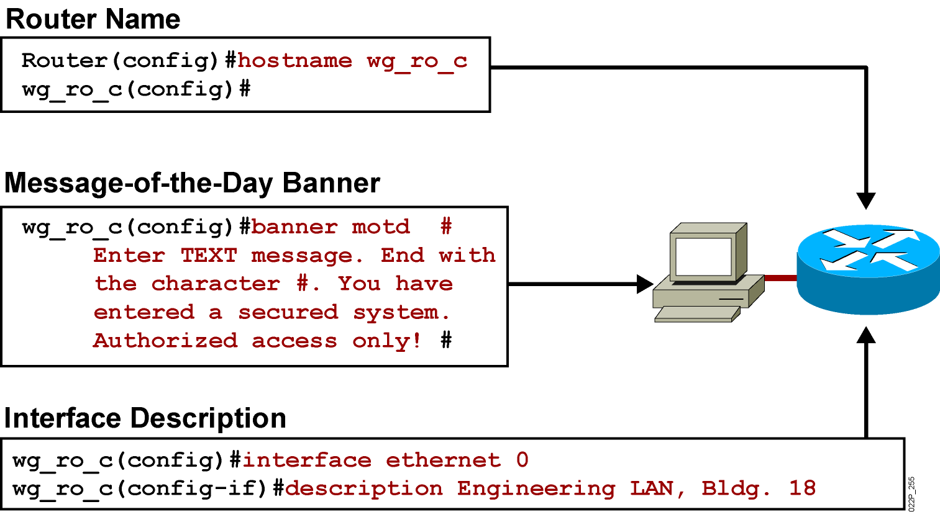
Configuring Router Identification
Notes:
Slide 2 of 2
Emphasize: Layer 2—The interface description command allows you to enter a one-line descriptive statement for each interface. This description is displayed in the output from the show interfaces command and appears in the show running-config and show startup-config listings.

Slide 4
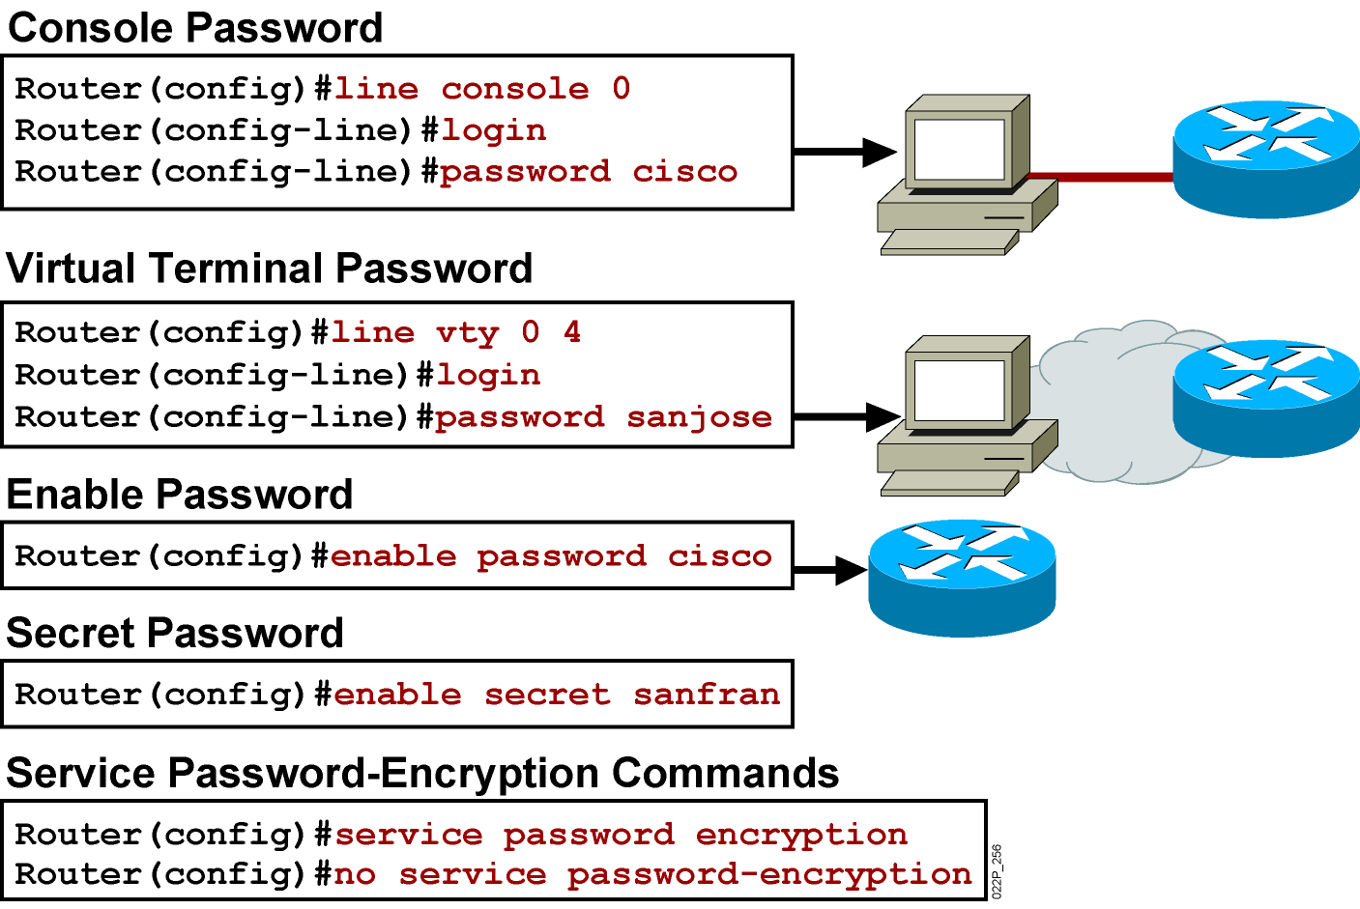
Configuring a Router Password
Notes:
Layer 2 of 2
Emphasize: The router has one enable password. Remember that this is your only protection. Whoever owns this password can do anything with the router, so be careful about communicating this password to others. To provide an additional layer of security, particularly for passwords that cross the network or are stored on a TFTP server, you can use either the enable password or enable secret commands. Both commands accomplish the same thing; that is, they allow you to establish an encrypted password that users must enter to access enable mode (the default), or any privilege level you specify. Cisco recommends that you use the enable secret command because it uses an improved encryption algorithm. Use the enable password command only if you boot an older image of the Cisco IOS software, or if you boot older boot ROMs that do not recognize the enable secret command. If you configure the enable secret password, it is used instead of the enable password, not in addition to it.
Cisco supports password encryption. Turn on password encryption using the service password-encryption command. Then enter the desired passwords for encryption. Immediately, on the next line, enter the no service password-encryption command. Only those passwords that are set between the two commands will be encrypted. If you enter service password-encryption and then press Ctrl-Z to exit, all passwords will be encrypted.
Note: Password recovery is not covered in the course materials. Refer the students to the IMCR class.

Slide 5
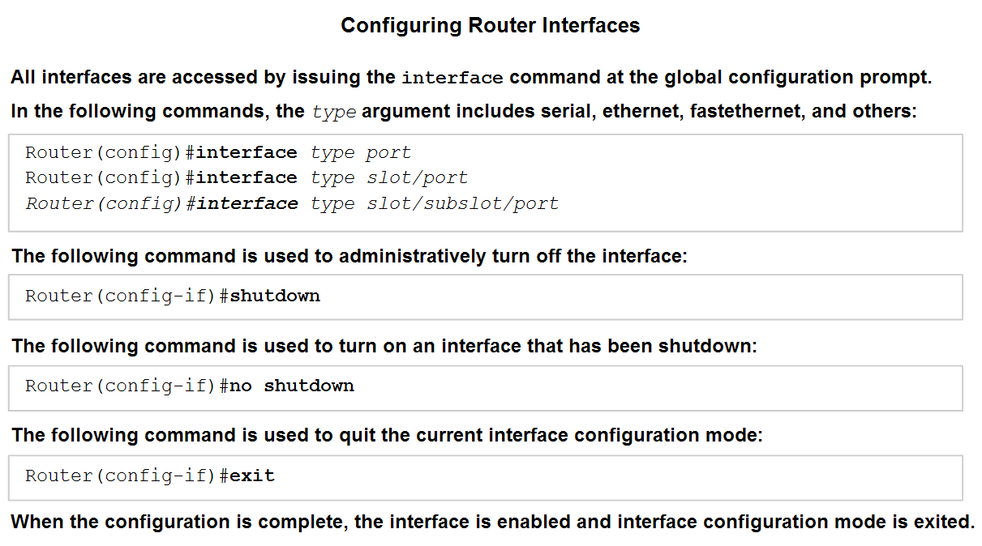
Configuring Interfaces
Identify the role of a router in a network.

Slide 6

Configuring Interfaces
S0/1
S0/0
192.168.1.2/30
192.168.1.1/30
Router#config t
RouterA(config)# interface serial 0/0
RouterA(config-if)# ip address 192.168.1.1 255.255.255.0
RouterA(config-if)# no shutdown
RouterA(config-if)# clock rate 56000 (required for serial DCE only)
RouterA(config-if)# bandwidth 64 (a value in kbps)
RouterA(config-if)# exit
RouterB(config)# int serial 0/1
RouterB(config-if)# ip address 192.168.1.2 255.255.255.252
RouterB(config-if)# no shutdown
RouterB(config-if)# exit
RouterB(config)# exit
Router#
To know which interface is the DCE :
RouterA# show controller s0/0

Slide 7
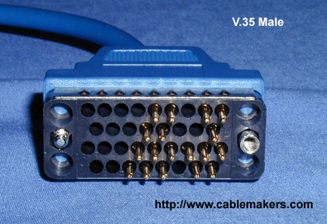
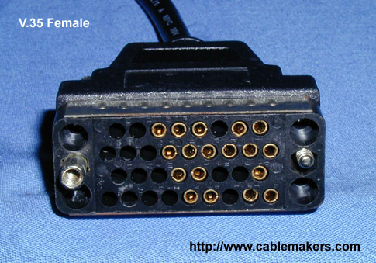
Configuring a serial interface
DTE Cable
DCE Cable
How can you tell which end is the DTE and which end is the DCE?
Look at the label on the cable.
Look at the connecter between the two cables - The DTE cable will always be male and the DCE cable will always be female.

Slide 8
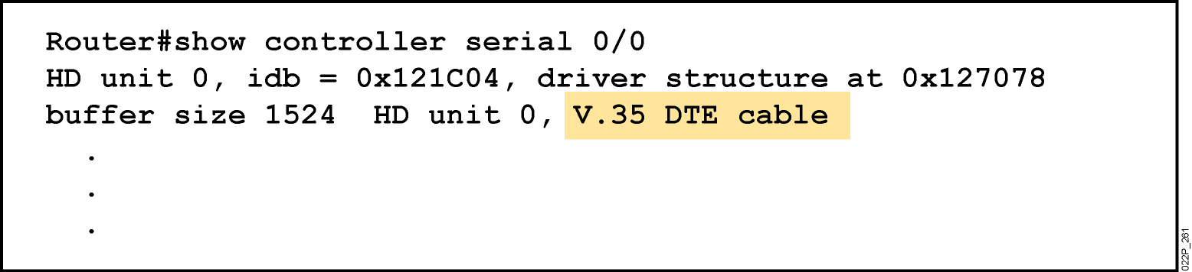
Serial Interface show controller Command
  Shows the cable type of serial cables
Notes:
Emphasize: This command requires a space between the word serial and the interface number. The router only checks for the cable type at powerup.

Slide 9
Interfaces
Router#show ip interface brief
Interface IP-Address OK? Method Status Protocol
FastEthernet0/0 unassigned YES unset administratively down down
Serial0/0 unassigned YES unset administratively down down
BRI0/0 unassigned YES unset administratively down down
BRI0/0:1 unassigned YES unset administratively down down
BRI0/0:2 unassigned YES unset administratively down down
Serial0/1 unassigned YES unset administratively down down
Router#

Slide 10
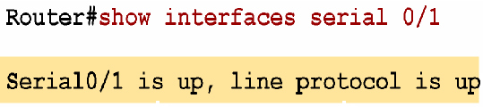
Interpreting the Interface Status
S0/1
S0/0
Interface is working properly
Layer 1 status
Layer 2 status
Other interface status :
- Serial0/1 is administratively down , line protocol is down
interface is shut down
- Serial0/1 is down , line protocol is down
interface or cable H/W failure ( no keep-alives )
- Serial0/1 is up , line protocol is down
different encapsulation type ( PPP , HDLC , FR ) or no clock rate on the DCE device.
Notes:
Purpose: This slide explains how to interpret the show interfaces serial command output.
Emphasize: The show interfaces serial command output indicates that the serial interface is up and the line protocol is up. The first parameter refers to the hardware layer and essentially reflects whether the interface is receiving the Carrier Detect signal from the other end. The second parameter refers to the data link layer. This parameter reflects whether the data link layer protocol keepalives are being received.
If both the interface and the line protocol are up, the connection is operational.
If the hardware is up and the line protocol is down, a connection problem exist such as no clocking, wrong encapsulation type, or no keepalives.
If both the line protocol and the interface are down, a cable might never have been attached to the router. On the serial cable, you can plug in the cable upside-down, causing the pins on the serial cable to break.
There is one more possibility. If the information says “administratively down,” you have manually disabled (shut) the interface.
Cisco offers a hardware class (IMCR) that discusses the router hardware in more detail.

Slide 11
Verification tools
You have to verify all config. steps
  Verify host identification.
  Verify router passward setting
  Verify interface configuration

Slide 12
Managing Console Input
Router(config)#line console 0
Router(config-line)#logging synchronous
Router(config-line)#exec-timeout 0 0
Router(config-line)#exit
Router(config)#no ip domain-lookup

Slide 13
SECTION SUMMARY
Configuring Router Identification
Configuring a Router Password
Configuring Interfaces
Basic Switch configuration

Slide 14
Viewing, Saving and Erasing the Configurations

Slide 15
running-config
Router#show running-config
Current configuration : 542 bytes
!
version 12.2
!
interface FastEthernet0/0
no ip address
shutdown
duplex auto
speed auto
!
interface Serial0/0
no ip address
shutdown
!
line con 0
line aux 0
line vty 0 4
!
end
Router#
The running-config file is the configuration in RAM memory.
All changes are made to the running-config file.
This is the configuration that the router is currently using.
The running-config is lost when the router loses power or reloads.
Privilege mode command.

Slide 16
startup-config
Router#show startup-config
startup-config is not present
Router#
The startup-config file is the saved configuration in NVRAM.
If there is a startup-config file in NVRAM when the router boots up, this file will be copied into running-config.
The running-config is what the router will use.
Privilege mode command.

Slide 17
Copy running-config to startup-config
Router#copy running-config startup-config
Destination filename [startup-config]? <Press Enter>
Building configuration...
[OK]
Router#show startup-config
Current configuration : 542 bytes
!
version 12.2
!
interface FastEthernet0/0
<text omitted>

Slide 18
Erase startup-config
Router#erase startup-config
Erasing the nvram filesystem will remove all files! Continue? [confirm] <Press Enter>
[OK]
Erase of nvram: complete
Router#
When you are done with the routers in the lab, please be sure to erase the startup-config.
If you are starting a lab, and you do not get the message:
Would you like to enter the initial configuration dialog? [yes/no]:
You will need to erase the startup-config and reboot.
Privilege mode command.

Slide 19
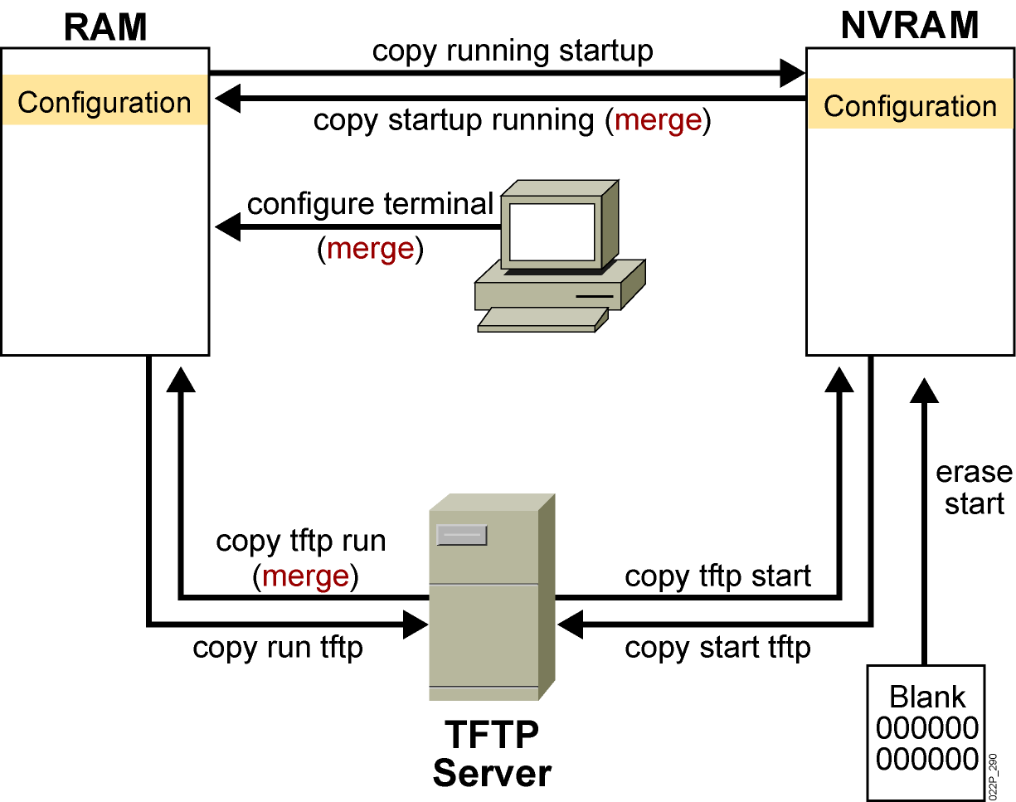
Cisco IOS copy Command
To save IOS image or configuration file
#
#
#
#
#
#
Notes:
Layer 4 of 4

Slide 20
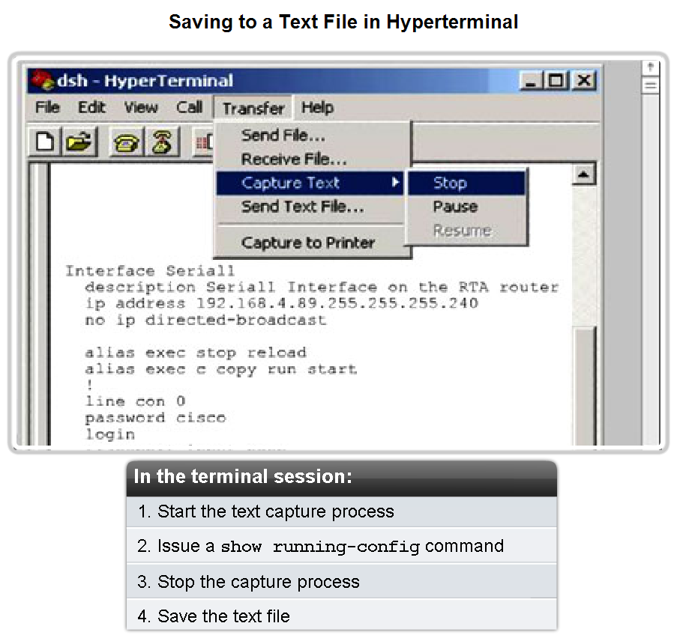
Managing configuration files
Use a text file to backup and restore config settings

Slide 21
Return the Device to Its Original Configuration
Router#reload
System configuration has been modified. Save? [yes/no]: n
Proceed with reload? [confirm]
To erase the startup configuration file use erase NVRAM:startup-config or erase startup-config at the privileged EXEC mode prompt:
Router#erase startup-config

Slide 22
Discovering & testing the network

Slide 23
Cisco Discovery Protocol (CDP)
Cisco Discovery Protocol (CDP) is a powerful network-monitoring and –troubleshooting tool.
CDP is an information-gathering tool used by network administrators to get information about directly connected Cisco devices.
CDP is a proprietary tool that enables you to access a summary of protocol and address information about Cisco devices that are directly connected.

Slide 24
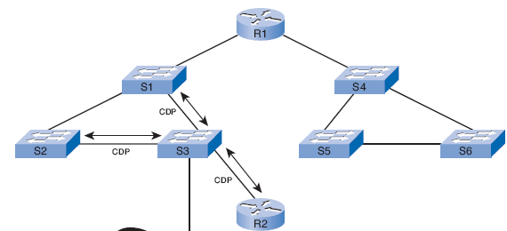
CDP Advertisements
By default, each Cisco device sends periodic messages to directly connected Cisco devices.
These messages are known as CDP advertisements.
A Cisco device frequently has other Cisco devices as neighbors on the network.
Information gathered from other devices can assist you:
  in making network design decisions
  in troubleshooting
  in making changes to equipment.
  CDP can be used as a network discovery tool

Slide 25
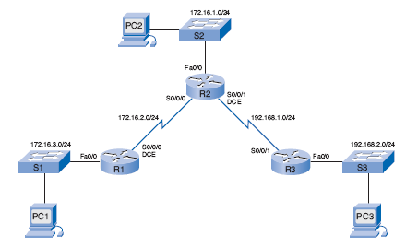
Layer 2 Neighbors
CDP operates at Layer 2 only.
Therefore, CDP neighbors are Cisco devices that are directly connected physically and share the same data link.
  R1 ,S1, R2 are CDP neighbors
  R2 , R1 , S2, R3 are CDP neighbors
  R3 ,R2 S3 are CDP neighbors

Slide 26
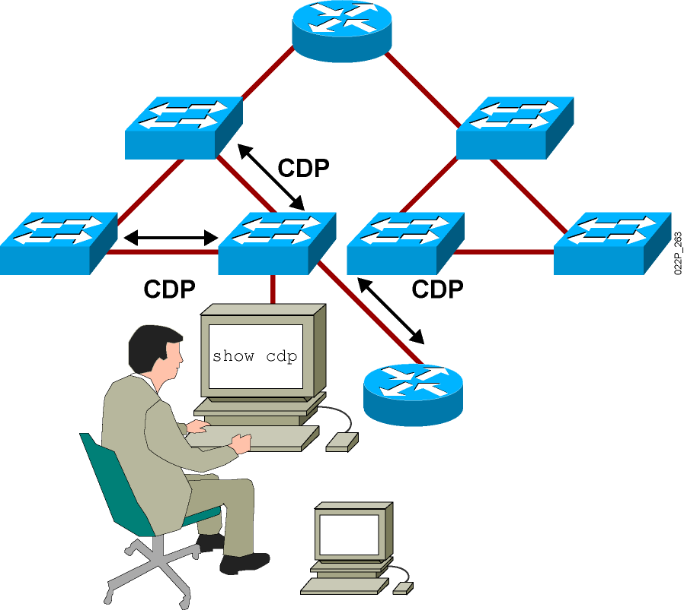
Discovering Neighbors with CDP
CDP runs on routers with Cisco IOS
to get information about the direct connected Cisco devices.
Summary information
includes:
  Device identifiers
  Address list
  Port identifier
  Capabilities list
  Platform
Notes:
Emphasize: CDP is media- and protocol-independent and runs on all Cisco-manufactured equipment including routers, access servers, switches, and some managed hubs. With CDP, network management applications can retrieve the device type and SNMP agent address of neighboring devices. This capability enables applications to send SNMP queries to neighboring devices.
CDP allows network management applications to dynamically discover Cisco devices that are neighbors. CDP runs on all media that support the Subnetwork Access Protocol, including LAN and Frame Relay. CDP runs over the data link layer only, not the network layer. Therefore, two systems that support different network-layer protocols can learn about each other.
Cached CDP information is available to network management applications. Cisco devices never forward a CDP packet. When new information is received, old information is discarded. The holdtime determines how long to keep existing information from a neighbor.

Slide 27
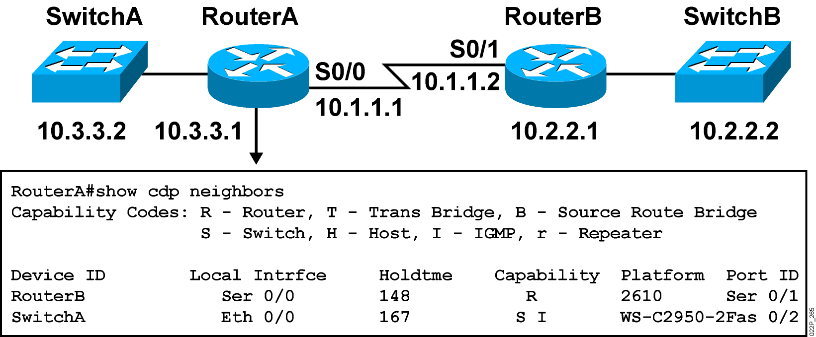
Using the show cdp neighbors Command
RouterA# show cdp neighbors detail
provide also the neighbors ip addresses.
Notes:
Emphasize: This graphic shows the show cdp neighbors command initiated from a router, which displays a summary of the capabilities and access details for the CDP neighbors. The show cdp neighbors detail command shows detailed information about the same devices.
Note: If the neighbor is a Catalyst 1900 switch, the switch MAC address is also displayed. If the switch is a 2900xl, its MAC address is not displayed.

Slide 28
SH CDP Neighbor detail
Cairo# sh cdp entry --------
Device ID: tanta
Entry address(es):
IP address : 192.168.2.1
Platform: cisco C2800, Capabilities: Router
Interface: FastEthernet0/0, Port ID (outgoing port): FastEthernet0/1
Hold time: 155
Version :
Cisco IOS Software, 2800 Software (C2800NM-IPBASE-M), Version 12.3(14)T7, RELEASE SOFTWARE (fc2)
advertisement version: 2
Duplex: full
---------------------------

Slide 29
Enabling CDP on a Router
To enable CDP, use the cdp run global configuration command. CDP is on by default. Use the no form of this command to disable CDP.
Router(config)#cdp run
To enable Cisco Discovery Protocol (CDP) on an interface, use the cdp enable interface configuration command. Use the no form of this command to disable CDP on an interface. CDP is enabled by default on all supported interfaces.
Router(config)#interface serial 0/0
Router(config-if)#cdp enable

Slide 30
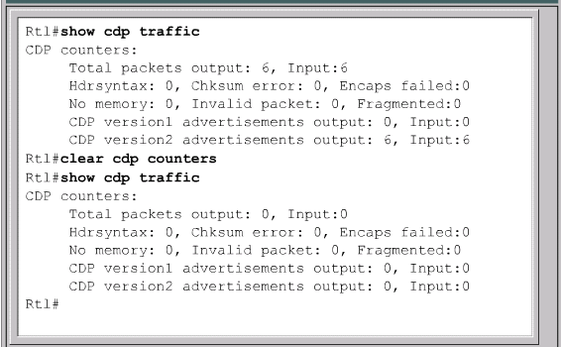
clear cdp counters

Slide 31
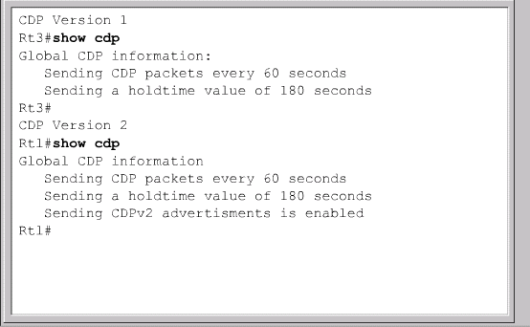
show cdp

Slide 32
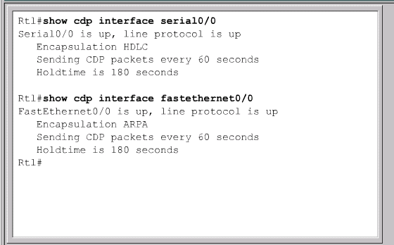
show cdp interface
Status of the carrier detect signal
Keepalive messages

Slide 33
Other cdp commands
show cdp traffic – shows number of packets sent and received
cdp timer - specifies how often the IOS sends CDP updates
debug cdp - for debugging all aspects of cdp

Slide 34
Disabling CDP
Router(config)# no cdp run
or
Router(config-if)# no cdp enable
CDP can be a security risk.
To disable CDP globally, for the entire device, use this command: no cdp run
To stop CDP advertisements on a particular interface: no cdp enable

Slide 35
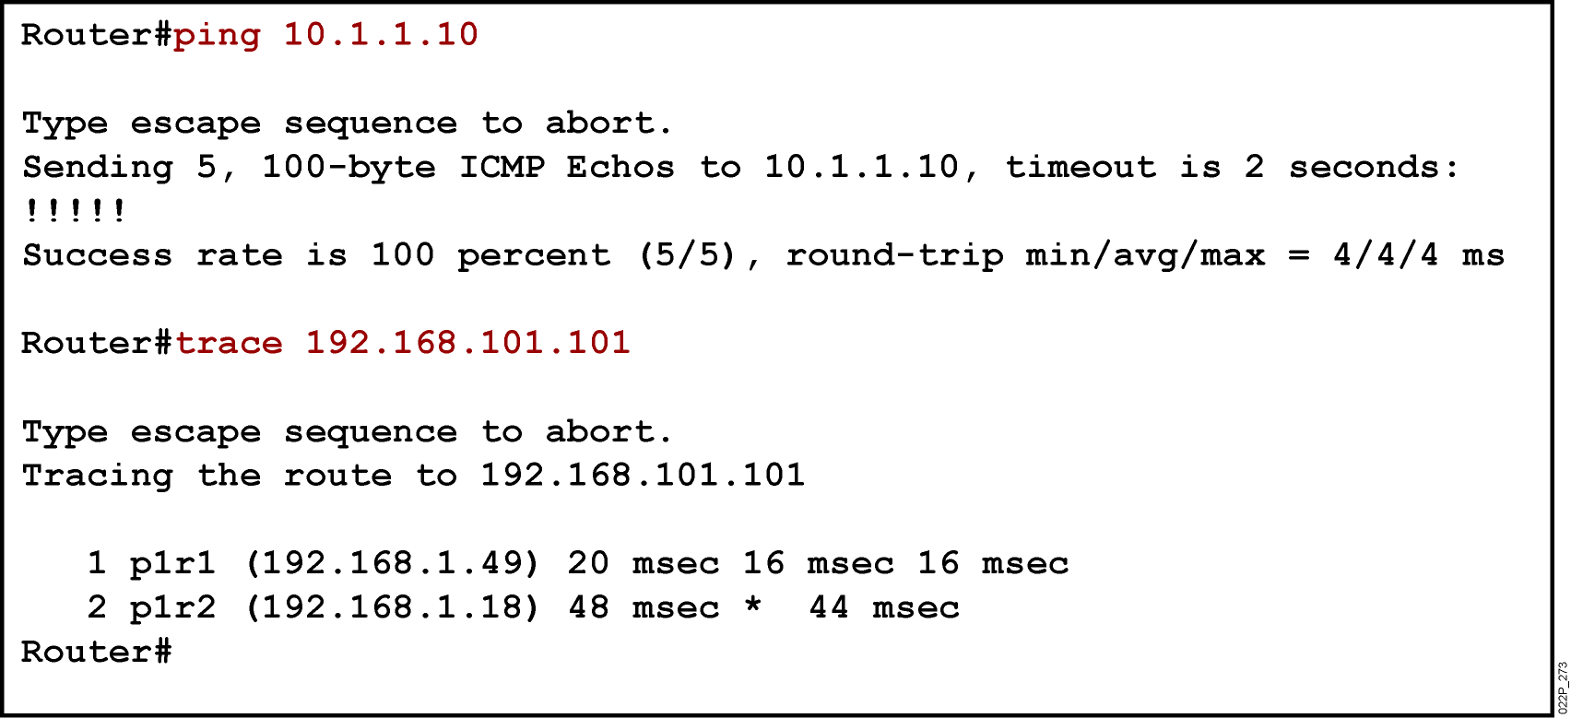
Using the ping and trace Commands
Ping commands tests the connectivity and path to a remote device
( test layer 3 in TCP/IP )
Notes:
Emphasize: As you use CDP and Telnet, you should note the information retrieved from the devices you successfully contacted. Documenting that information helps put the network into a visual perspective, and can be referenced at a later time.
This concludes the network discovery portion of the chapter. In the next section, we will discuss configuration file and Cisco IOS image management.

Slide 36
IOS Ping Indicators
A ping from the IOS will yield to one of several indications for each ICMP echo that was sent. The most common indicators are:
  ! - indicates receipt of an ICMP echo reply
  . - indicates a timed out while waiting for a reply
  U - an ICMP unreachable message was received
the ping command moves from Layer 3 of the OSI model to Layer 2 and then Layer 1. Ping uses the ICMP protocol to check for connectivity.

Slide 37
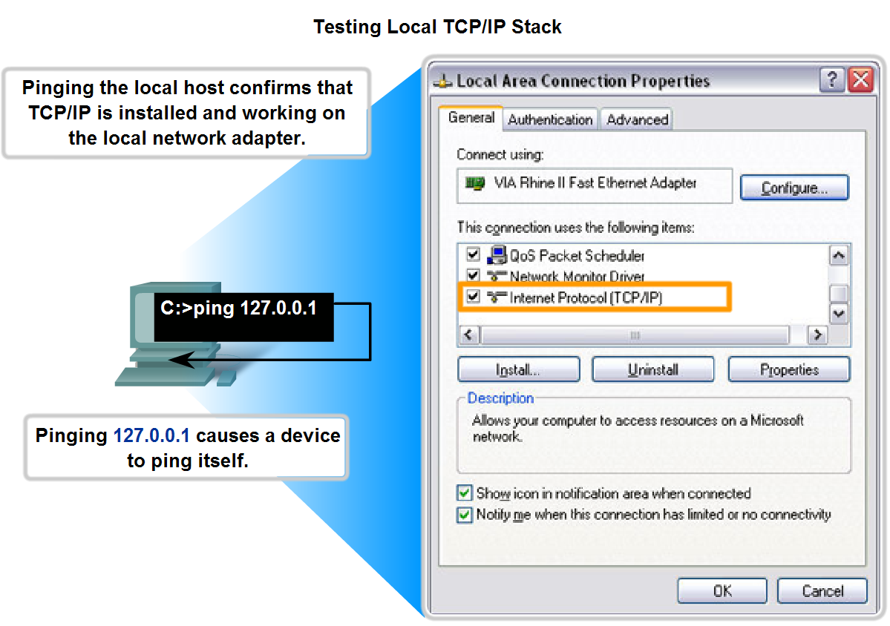
Test the Stack
Given a type of host and a master addressing scheme, trace the steps for assigning host parameters to a host

Slide 38
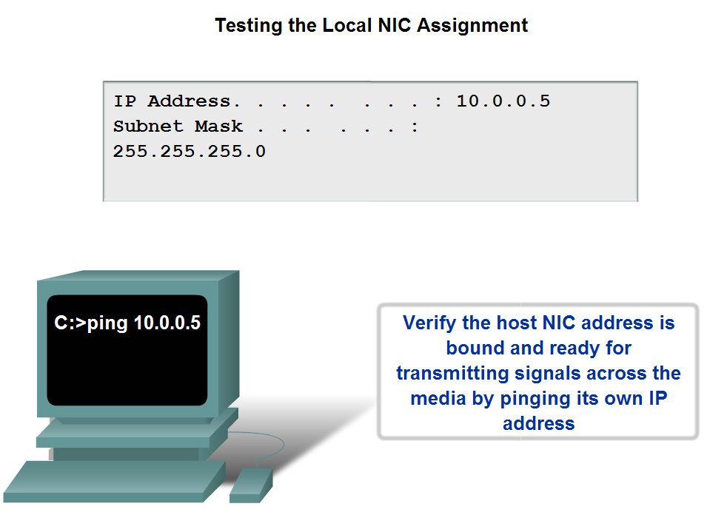
NIC
Use the ping command to determine if the IP protocol is properly bound to an NIC

Slide 39
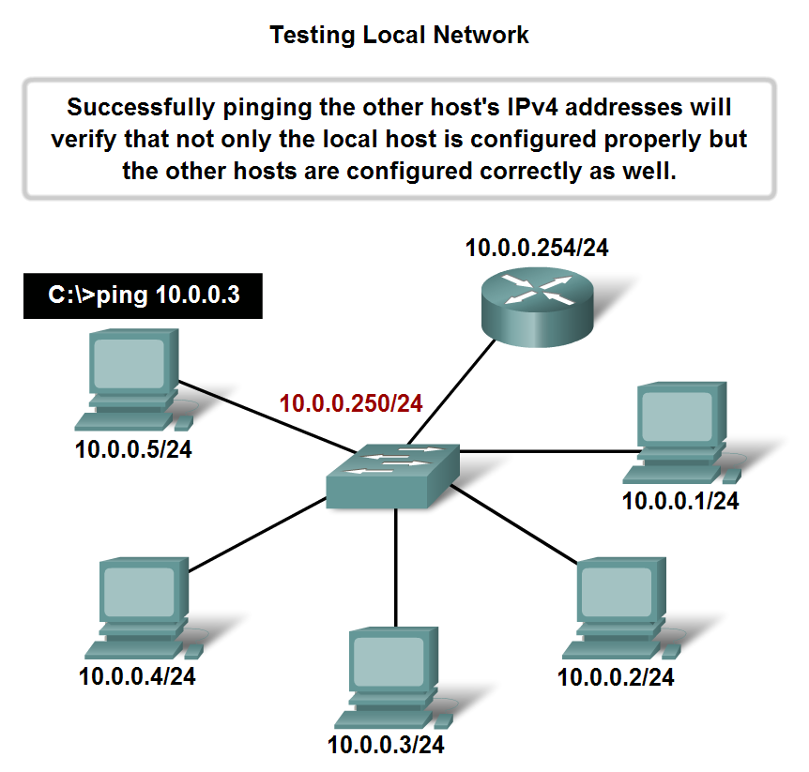
Testing the Local Network
Router#ping
Protocol [ip]:
Target IP address:10.0.0.1
Repeat count [5]:
Datagram size [100]:
Timeout in seconds [2]:5
Extended commands [n]: n

Slide 40
TELNET

Slide 41
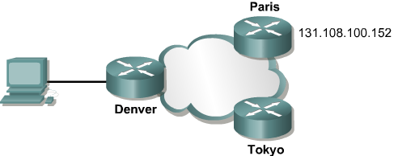
To initiate a Telnet session any of the following alternatives can be used:
Denver>connect paris
Denver>paris
Denver>131.108.100.152
Denver>telnet 131.108.100.152
Denver>telnet paris

Slide 42
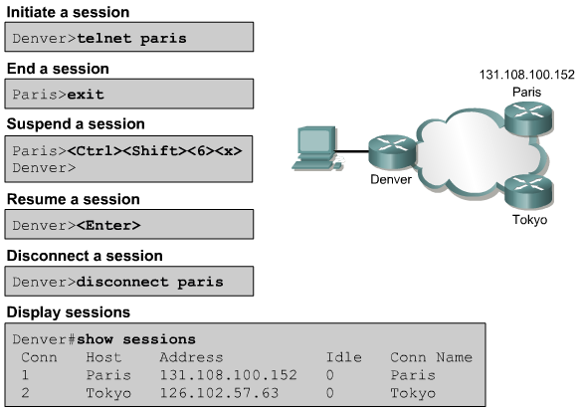
Reopening a suspended Telnet session

Slide 43
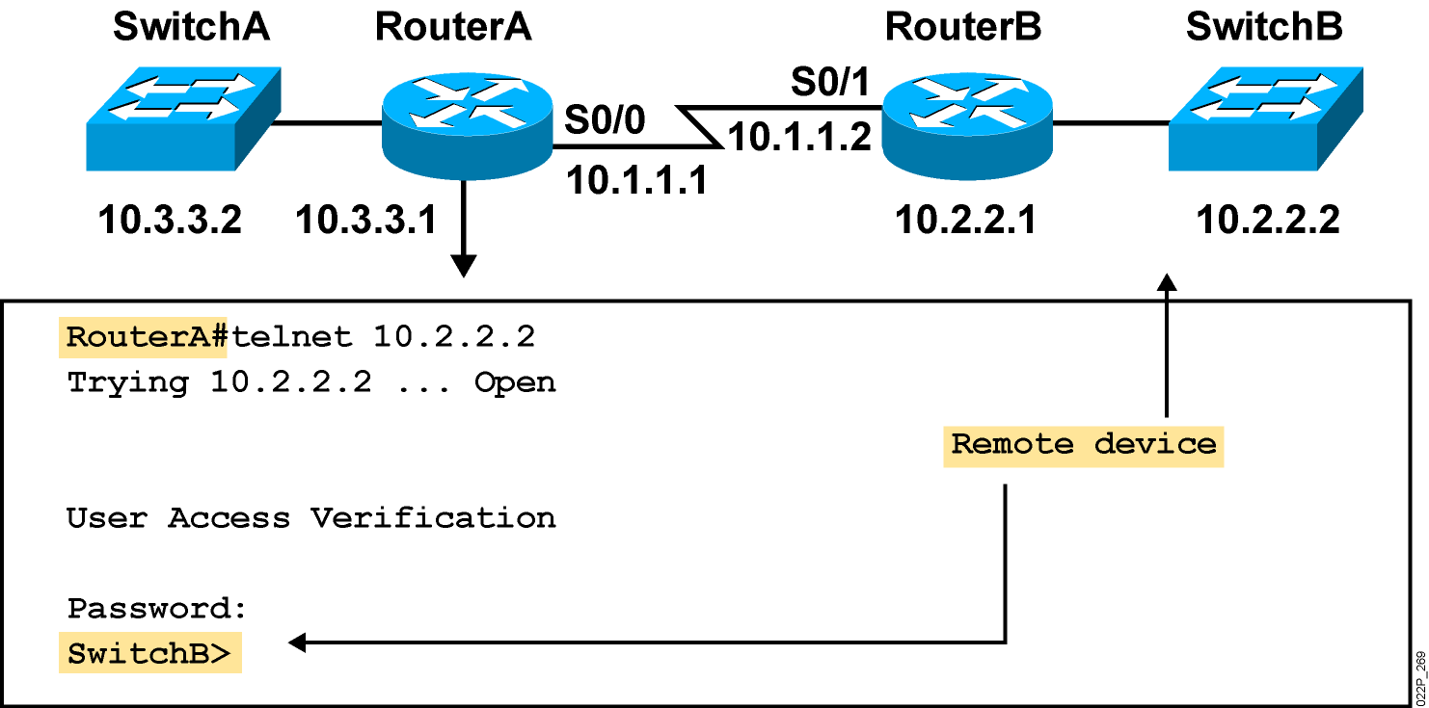
Using Telnet to Connect to Remote Devices
Telnet is used to check all the TCP/IP stack
Notes:
Emphasize: Another way to learn about a remote device is to connect to it. Telnet, a virtual terminal protocol that is part of the TCP/IP protocol suite, allows connections to remote hosts. By default, a router can have up to five simultaneous incoming Telnet sessions. With Cisco’s implementation of TCP/IP, you need not enter the connect or telnet command to establish a Telnet connection. If you prefer, you can just enter the learned host name, and the router will resolve the host name using DNS or a local host table. To end a Telnet session, use the exit or logout EXEC command.
These are alternate commands for the operations listed on the graphic:
Initiate a session:
Denver> connect paris
Denver> paris
Denver> 131.108.100.152
Resume a session (enter session number or name):
Denver> 1
Paris>
End a session:
Paris> exit
Note: The Catalyst 1900 can accept incoming Telnet connections but cannot initiate an outgoing Telnet session.

Slide 44
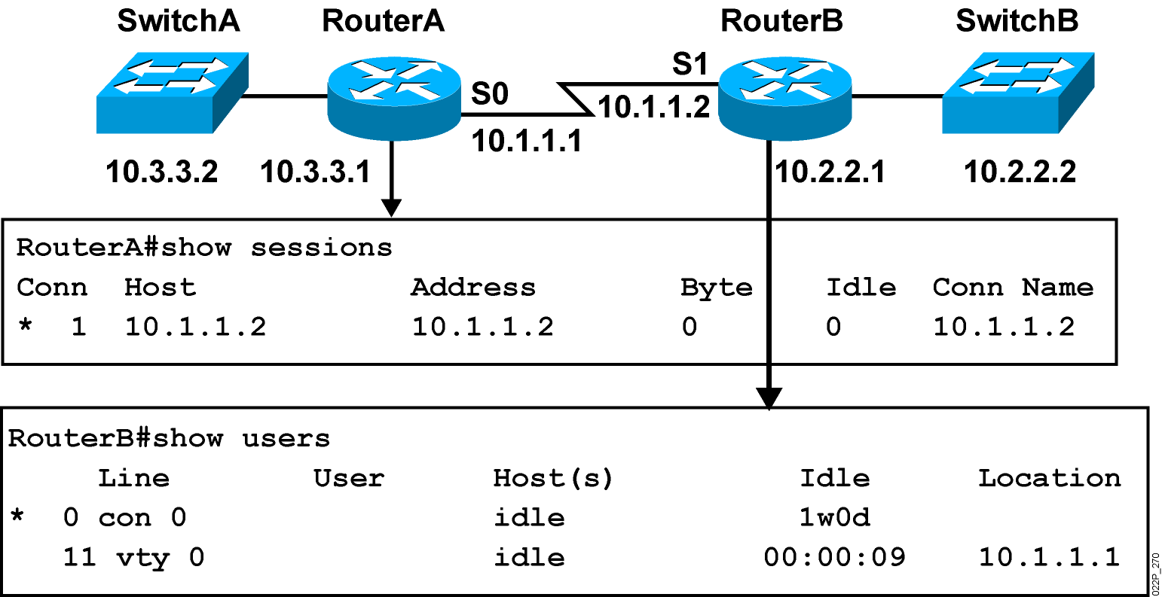
Viewing Telnet Connections
Notes:
Note: This output was taken from a 2522. Line 11 = vty 0.
You can send messages to one or all terminal lines. A common reason for doing this is to inform users of an impending shutdown. To send a message to other terminals, issue the following command:
send {line-number | *}
where line-number specifies the line number to which the message will be sent, and * indicates that the message will be sent to all lines.
The system prompts for the message, which can be up to 500 characters long. End the message by entering Ctrl-Z. Enter Ctrl-C to abort the command.

Slide 45
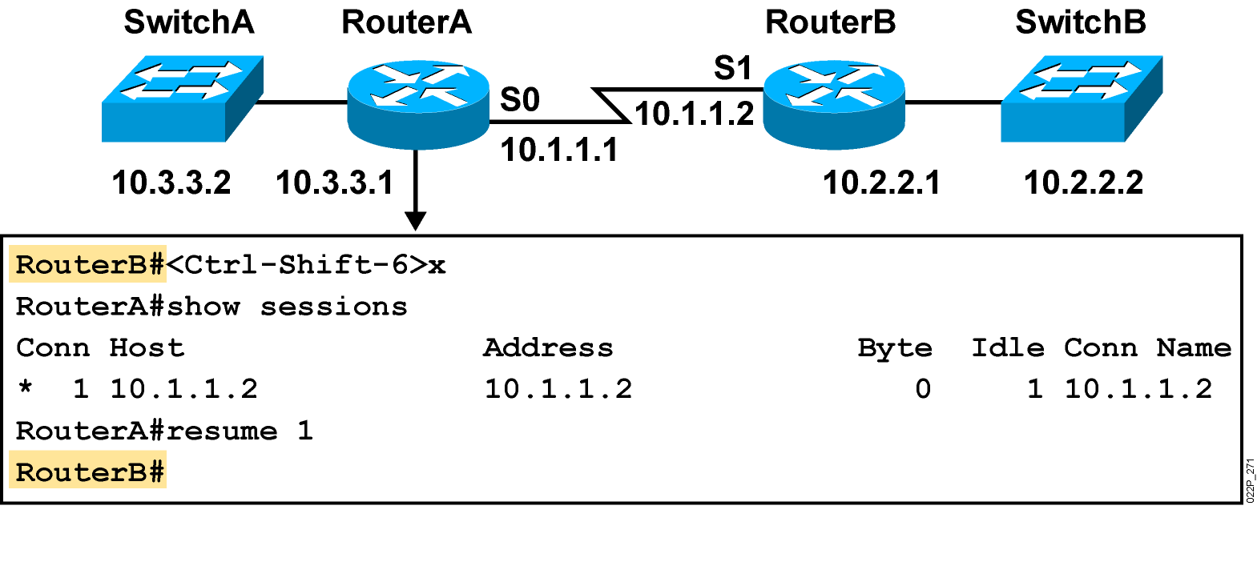
Suspending and Resuming a Telnet Session
Notes:
Emphasize: The key stroke sequence for Ctrl-Shift-6 and x.

Slide 46
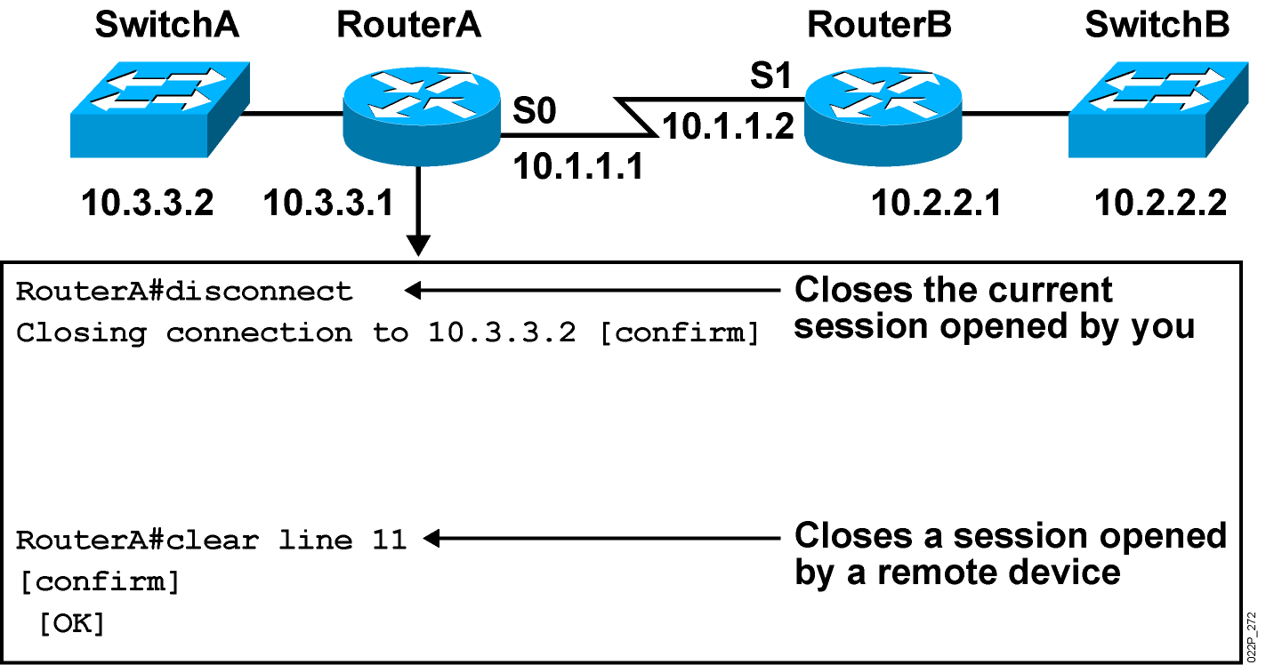
Closing a Telnet Session
Notes:
Note: Disconnecting without the session number disconnects that last active session.

Slide 47
Summary
Router Initialization.
Router Access
CLI First look
Basic configuration
Viewing, Saving and Erasing the Configurations
Discovering & testing the network
TELNET

